Slide 1
IOT BRIDGE HEALTH MONITORING SYSTEM
BSC-29-18 (ANDRINAH KAUNDA)
BSC-COM-NE-10-18(PATRICK MABZINESS)
BSC-04-16(TINASHE DZAUYA)
BSC-COM-NE-06-17(TERESA MFUSE)

Slide 2
Problem Statement
Bridges are a critical infrastructure that play a vital role in transportation and commerce. Their lifespan is often reduced due to environmental and operational factors such as cracks, weight, rains etc. Overtime these factors can cause wear and tear on bridge structure, leading to degradation of its structural integrity and potential safety hazards.
Recently, in Malawi we had cases where bridges have collapsed unexpectedly due to a number of factors. Most of these issues arise because there is no adequate method for ensuring whether the bridges are safe or not, we only assume that the bridges are safe .
Since the bridges are left unmonitored, the level of damages worsen overtime which eventually lead to bridges collapsing , and in some cases loss of lives and property .
Therefore, there is a need for an efficient and reliable bridge health monitoring system that provides real time data on the structural integrity of the bridge.
Notes:
For example, this year we have experienced cases like: the M2 Peter Muthalika road bridge which was damaged due to incessant(continuos) rains,
Lisungwi bridge damaged due to vibrations caused by cyclones and also two people were washed away together with the bridge in Machinjiri due to raging rains.

Slide 3
Objectives
The aim of this project is to design and develop an IOT based Bridge health monitoring System that can monitor the structural health of bridges continuously and remotely
The system should be able monitor various parameters such as strain, vibrations, deformation ,water level and cracks.
The system should be able to alert concerned authorities through our dashboard, and also close or open the road depending on the health status of the bridge.
Notes:
AMONG OTHERS: Monitor fatigue and collision of materials

Slide 4
Target users
Malawi Roads Authority
All road users.

Slide 5
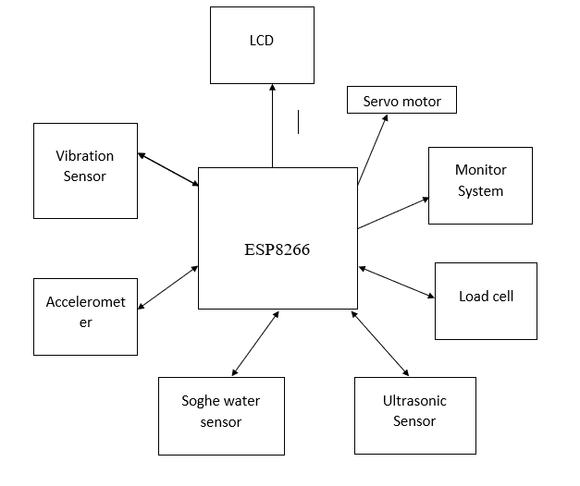
Design(Block diagram)
Notes:
For us to achieve this objective, we have microcontroller ESP8266 for the programming logic
So, we have sensors that will be used to get data
Vibration sensor : measuring vibrations in bridges
Soghe water sensor : this is for indicating water level
Ultrasonic sensor : for detecting cracks in bridges
Load cell : for sensing strain
5. Accelerometer : for tilt sensing
Other tools
Servo motor : for closing or opening the road depending on the data coming from ESP8266
Monitor system : the dashboard
LCD :

Slide 6
Functional Requirements
-The system should have a user-friendly interface that allows users to interact with the system, view data.
-A system should have a network of sensors to measure various parameters.(cracks, water level,tilt and weight).
-The system should be able to acquire data from the sensors in real-time and store it in a database.
-The system should be accessible remotely, allowing users to monitor the health of bridge.
-The system should notify relevant authorities and users through our dashboard and display on the screen on the health status of the bridges.

Slide 7
Tools
HARDWARE
Sensors : Vibration, Load cell, songhe Water level, ultrasonic , accelerometer.
Display : LCD.
Microcontroller : ESP8266
Others : Servo motor
SOFTWARE
PHP
MYSQL
JavaScript
bootstrap

